Slide 1
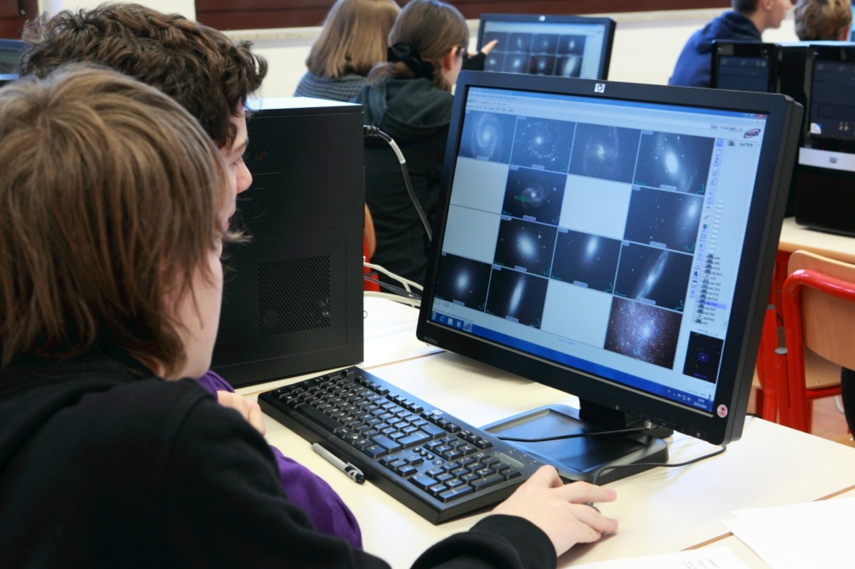
WP4 Outreach towards education and the general public
Massimo Ramella
INAF Osservatorio Astronomico di Trieste
CoSADIE Tech Forum 3, Trieste, March 12 – 13, 2013

Slide 2
Consolidation of outreach activities
CoSADIE use cases (focus on education)
Explore the sky w/ Messier using Aladin
Mass of Jupiter using Stellarium
Zodiacal constellations using Stellarium
Star clusters I using Aladin
Star clusters II using Aladin

Slide 3
Consolidation of outreach activities
CoSADIE tutorials for the general public
6 - Explore the Sky with Stellarium
7 - Discover Astronomical objects with Aladin

Slide 4
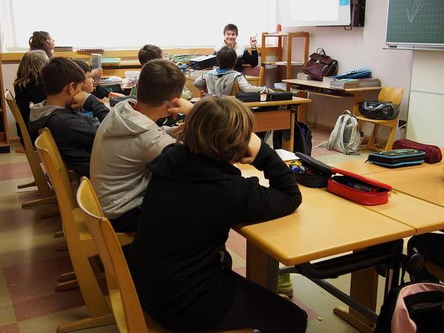
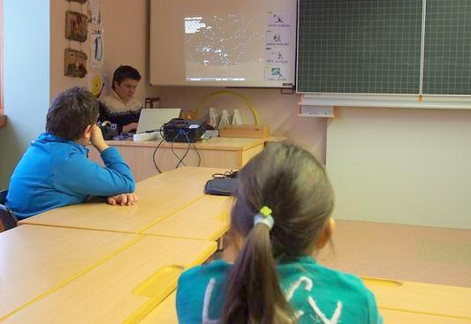
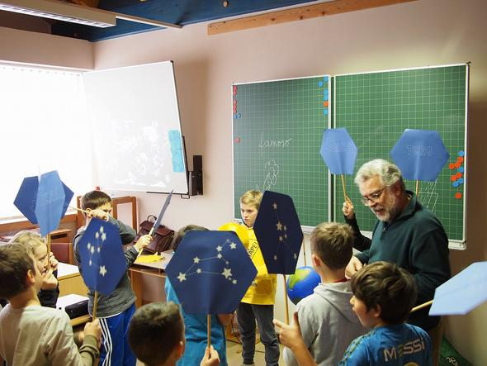
VO Edu within elementary schools:
More experiences in 2014

Slide 5
Consolidation of outreach activities
VO Edu within major EPO projects in Italy
Italian network of remote telescopes
Italian Astronomy Olympiads

Slide 6
VO Edu & EUHOU – MW
VO for a European Edu Network
Access to data and use of software tools
Virtual learning best practices
Strategies to enter the school system

Slide 7
VO for a European Edu Network
VO Edu (WP4) linked to the
Astronet EPO WG
Astronet current mission:
establish a permanent mechanism for planning and coordination in European astronomy
follow-up and implementation of the Roadmap

Slide 8
VO for a European Edu Network
From the Astronet community:
Great interest in VO data but also in publishing educational data in VO
Great interest in VO tools

Slide 9
VO for a European Edu Network
Actions undertaken, also as IVOA EduIG:
develop a Virtual observatory Educational Service Publisher and Archive application (VESPA, Francesco Cepparo, this afternoon)
organize an Edu-IG & SVN repo for tutorials (Giulia Iafrate & Marco Molinaro, next talk)

Slide 10
Sustainability
Issues:
Declining political interest toward investing into astronomy in schools
Long time scale needed to enter a nation-wide school organization
Cost of translating EPO products exceeds funding, yet translations are essential

Slide 11
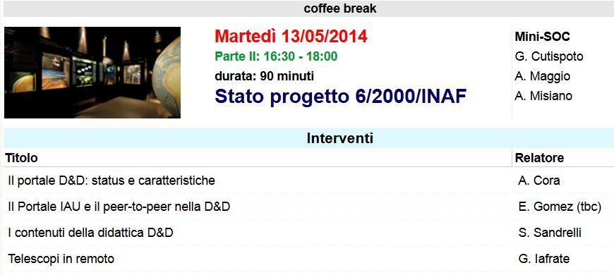

Slide 13
WP4:

